Slide 1


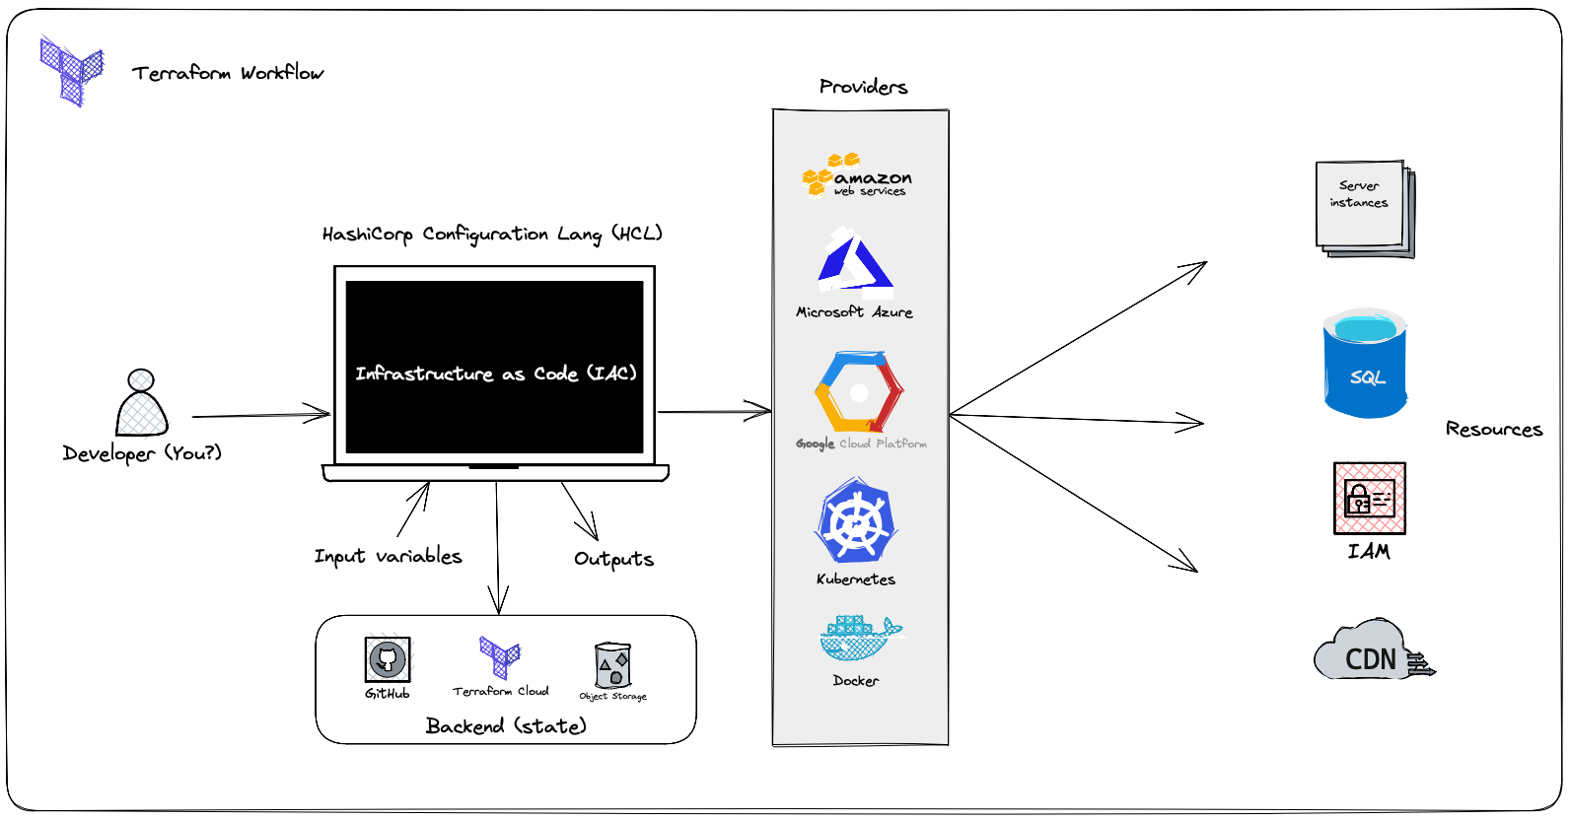
UI Test Automation Framework
SAME CODEBASE - DIFFERENT TECHNOLOGIES
SIMILAR GENERAL CONCEPT: TERRAFORM

Slide 2
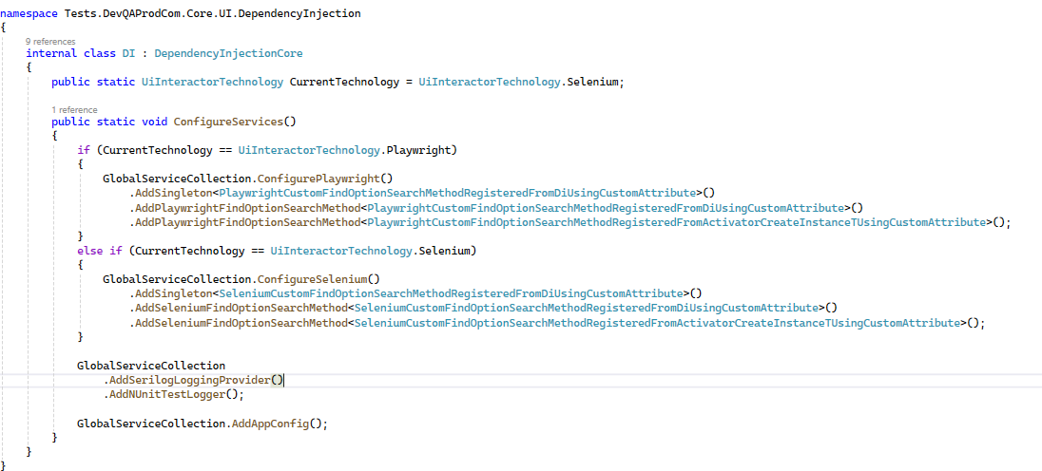
CONFIGURE/SWITCH TECHNOLOGIES
USING DEPENDENCY INJECTION

Slide 3



UiInteractorsManager
GENERAL ARCHITECTURE
UiInteractor
UiInteractor
AUTO SWITCHING
UiInteractorTab
(DefaultTab)
UiInteractorTab
(Tab2, Tab3, Tab4 …)
UiPage
(Login Page)
UiPage
(Home Page)
UiPage
(Users Page)
UiElement (Table)
UiElementsList <Row>
SingleUiPageService
(Login Page Service)
SingleUiPageService
(Home Page Service)
SingleUiPageService
(Users Page Service)
MultipleUiPagesService
(Navigation Service)

Slide 4
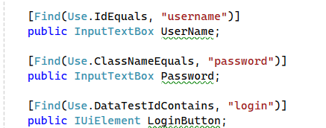
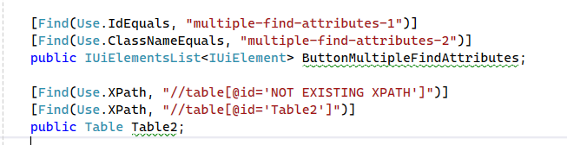
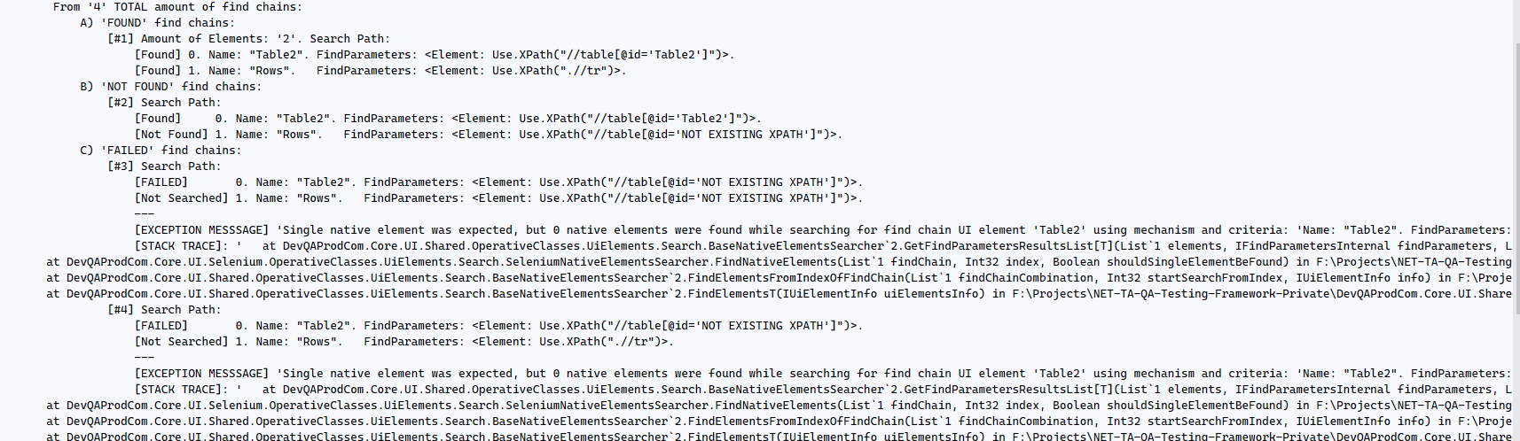
PAGE FACTORY
STATIC UiElements INSTANTIATION
MULTIPLE FIND ATTRIBUTES

Slide 5
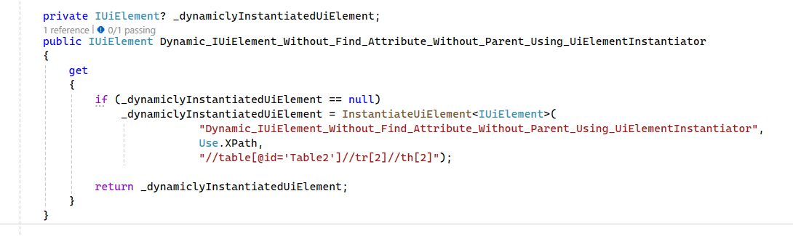

DYNAMIC UiElements INSTANTIATION
FRAMES UiElements support with AUTO SWITCHING
Find Attribute with Frame Info
Frame Attribute

Slide 6
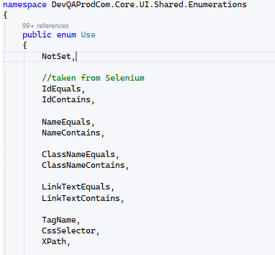
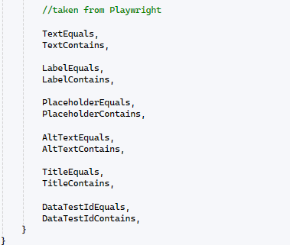

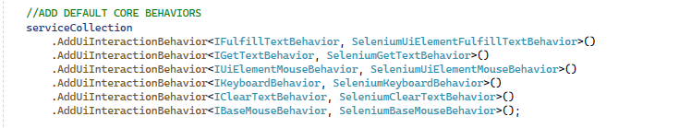
SUPPORTED FIND METHODS
CUSTOM FIND METHODS
ADD BEHAVIOR

Slide 7
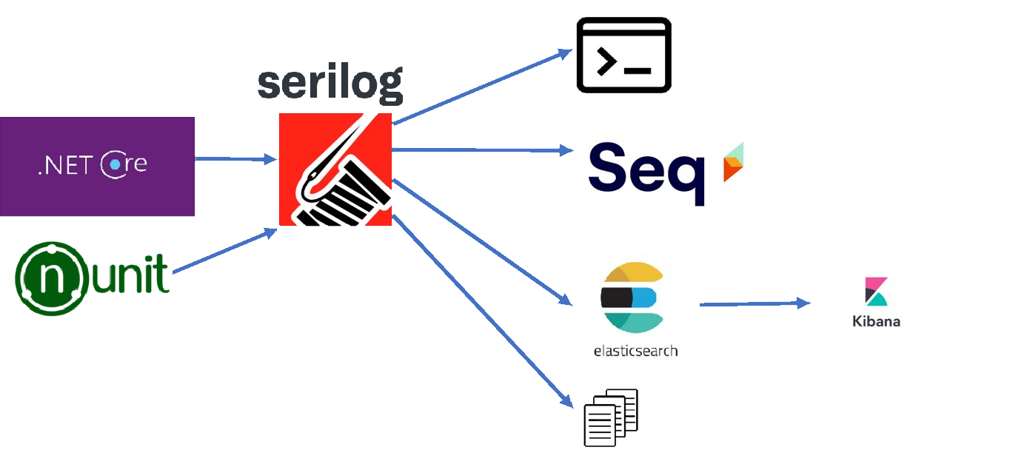
ADVANCED
PARAMETERIZED LOGGING
NUNIT ADDIN

Slide 8
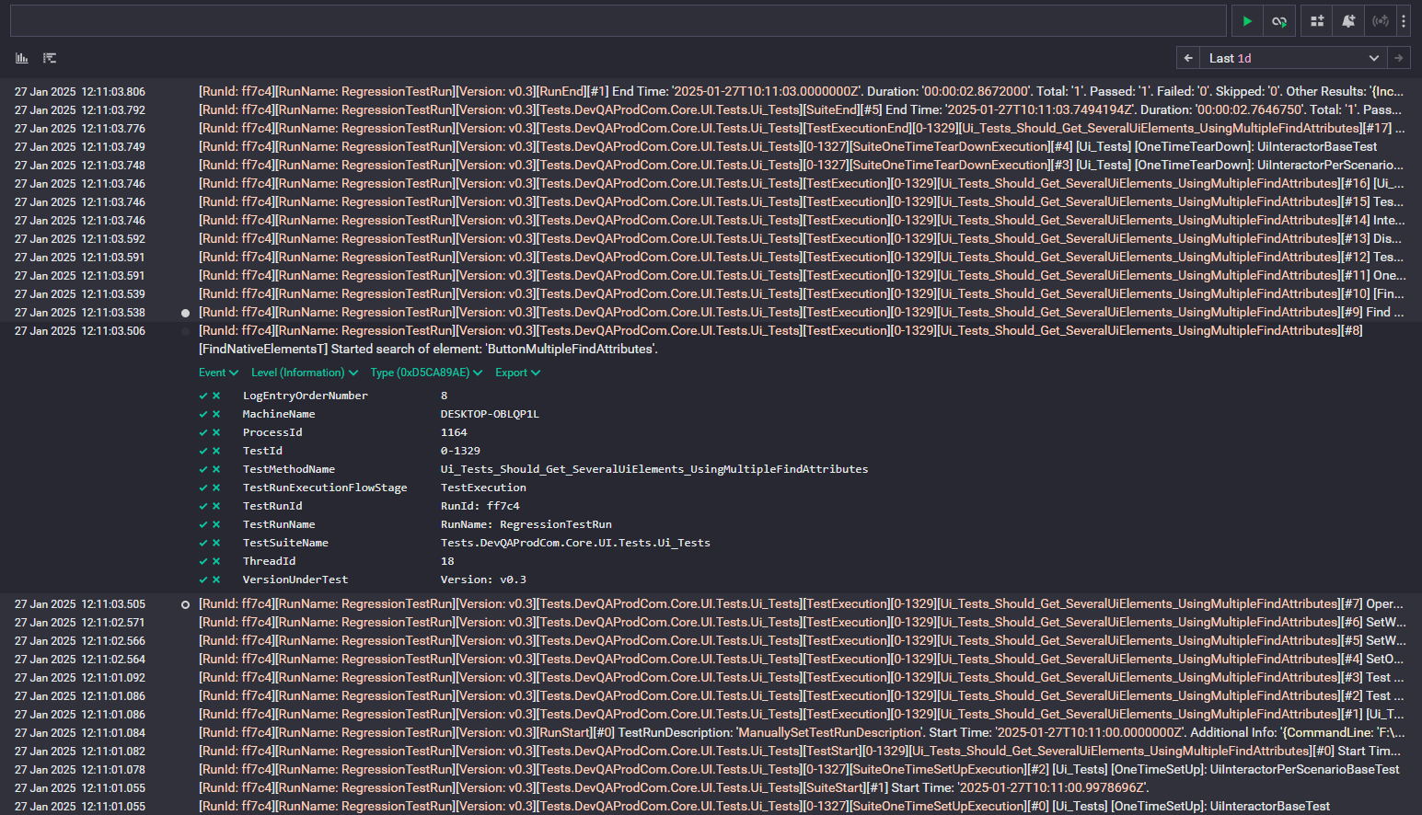

Slide 9
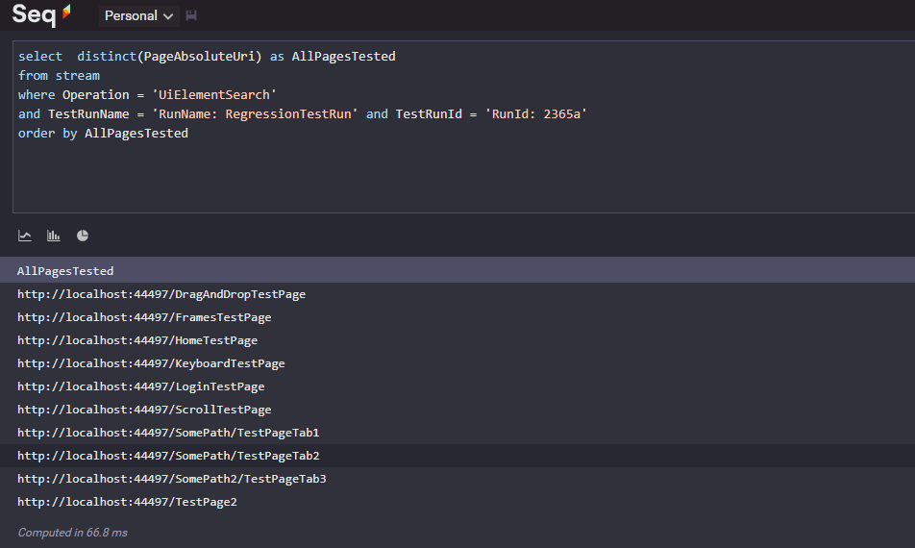
SELECT ALL PAGES TESTED (in particular RUN)

Slide 10
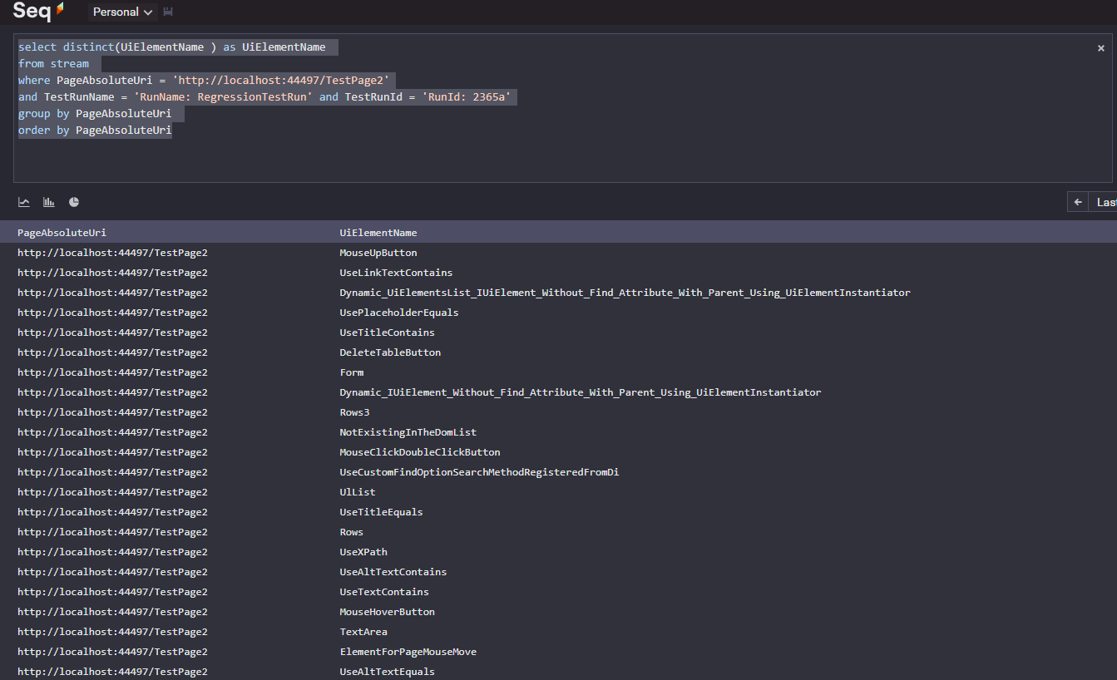
SELECT ALL COMPONENTS TESTED (on particular PAGE)

Slide 11
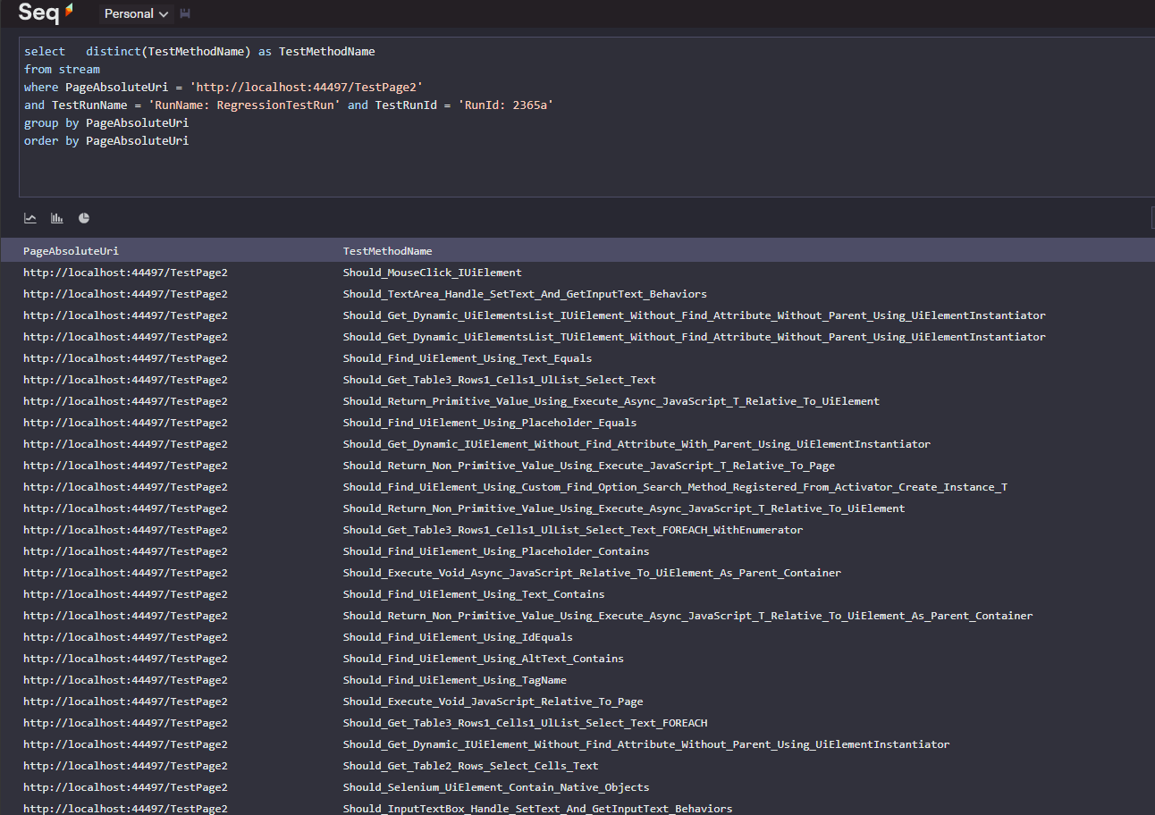
SELECT ALL TESTS which test particular PAGE

Slide 12
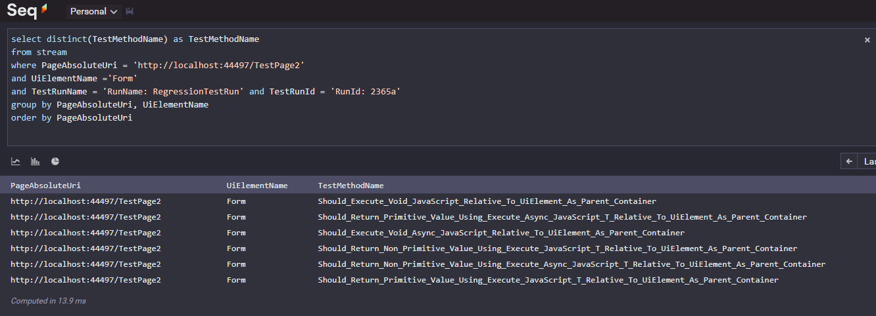
SELECT ALL TESTS that test particular COMPONENT (on particular PAGE)
AND MANY OTHER QUERIES:
SELECT TESTS BY CATEGORIES
SELECT PASSED/FAILED TESTS
etc.
USAGE AREAS:
- Build DASHBOARDS with Regression Testing Results
- Find any other specific information about what happens during testing

